Slide 1
SE301: Numerical Methods
Topic 5:
Interpolation
Lectures 20-22:
KFUPM
Read Chapter 18, Sections 1-5
CISE301_Topic5

Slide 2
Lecture 20
Introduction to Interpolation
Introduction
Interpolation Problem
Existence and Uniqueness
Linear and Quadratic Interpolation
Newton’s Divided Difference Method
Properties of Divided Differences
CISE301_Topic5

Slide 3
Introduction
Interpolation was used for long time to provide an estimate of a tabulated function at values that are not available in the table.
What is sin (0.15)?
x | sin(x)
0 | 0.0000
0.1 | 0.0998
0.2 | 0.1987
0.3 | 0.2955
0.4 | 0.3894
Using Linear Interpolation sin (0.15) ≈ 0.1493
True value (4 decimal digits) sin (0.15) = 0.1494
CISE301_Topic5

Slide 4
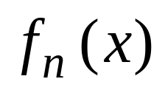
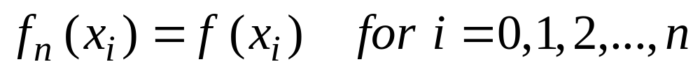
The Interpolation Problem
Given a set of n+1 points,
Find an n^{th} order polynomial
that passes through all points, such that:
CISE301_Topic5

Slide 5
Example
An experiment is used to determine the viscosity of water as a function of temperature. The following table is generated:
Problem: Estimate the viscosity when the temperature is 8 degrees.
Temperature (degree) | Viscosity
0 | 1.792
5 | 1.519
10 | 1.308
15 | 1.140
CISE301_Topic5

Slide 6
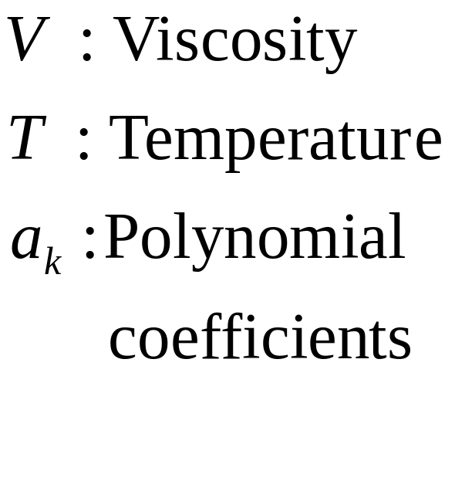
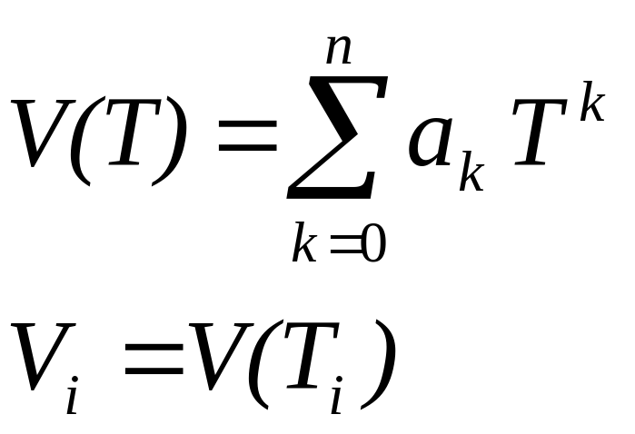
Interpolation Problem
Find a polynomial that fits the data points exactly.
Linear Interpolation: V(T)= 1.73 − 0.0422 T
V(8)= 1.3924
CISE301_Topic5

Slide 7
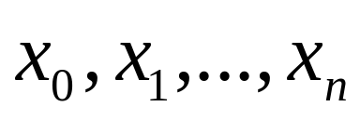
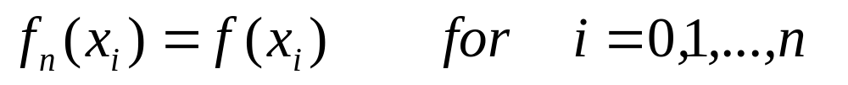
Existence and Uniqueness
Given a set of n+1 points:
Assumption: are distinct
Theorem:
There is a unique polynomial f_{n}(x) of order ≤ n such that:
CISE301_Topic5

Slide 8
Examples of Polynomial Interpolation
Linear Interpolation
Given any two points, there is one polynomial of order ≤ 1 that passes through the two points.
Quadratic Interpolation
Given any three points there is one polynomial of order ≤ 2 that passes through the three points.
CISE301_Topic5

Slide 9
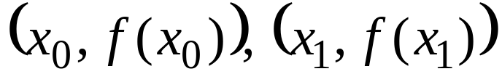
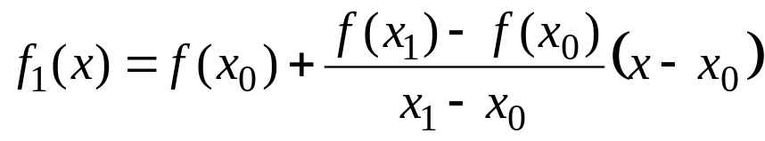
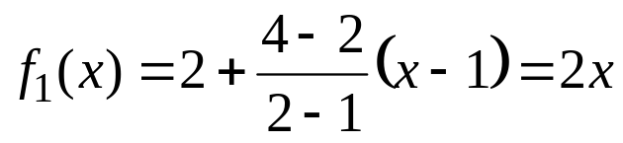
Linear Interpolation
Given any two points,
The line that interpolates the two points is:
Example :
Find a polynomial that interpolates (1,2) and (2,4).
CISE301_Topic5

Slide 10
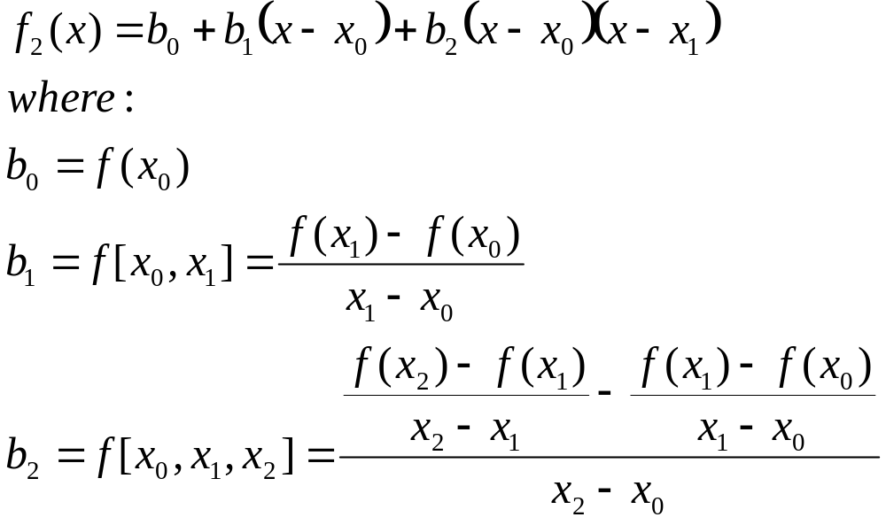
Quadratic Interpolation
Given any three points:
The polynomial that interpolates the three points is:
CISE301_Topic5

Slide 11

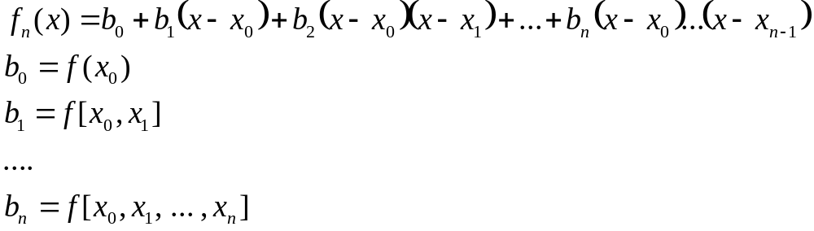
General n^{th} Order Interpolation
Given any n+1 points:
The polynomial that interpolates all points is:
CISE301_Topic5

Slide 12
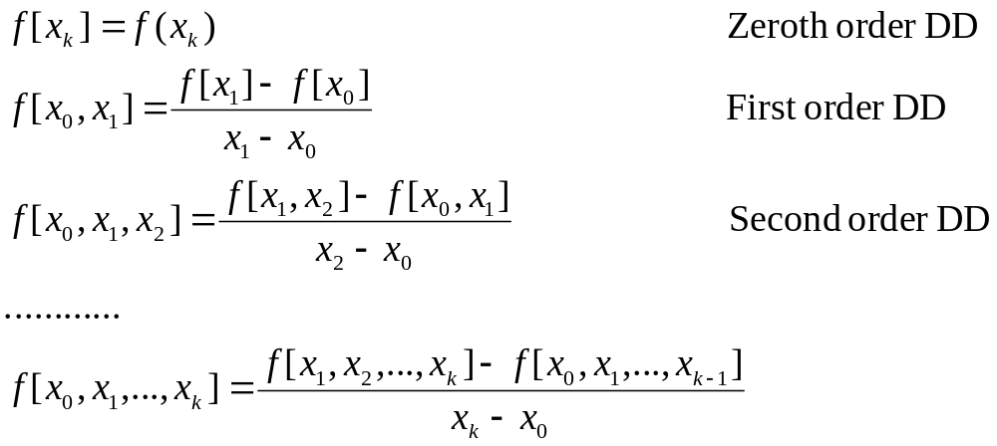
Divided Differences
CISE301_Topic5

Slide 13
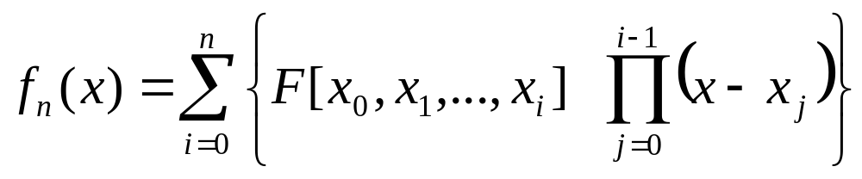
Divided Difference Table
x | F[ ] | F[ , ] | F[ , , ] | F[ , , ,]
x₀ | F[x0] | F[x₀,x₁] | F[x₀,x_{1,}x₂] | F[x₀,x₁,x₂,x₃]
x₁ | F[x₁] | F[x₁,x₂] | F[x₁,x₂,x₃]
x₂ | F[x₂] | F[x₂,x₃]
x₃ | F[x₃]
CISE301_Topic5

Slide 14

Divided Difference Table
x | F[ ] | F[ , ] | F[ , , ]
0 | -5 | 2 | -4
1 | -3 | 6
-1 | -15
 | f(x_{i})
0 | -5
1 | -3
-1 | -15
Entries of the divided difference table are obtained from the data table using simple operations.
CISE301_Topic5

Slide 15
Divided Difference Table
x | F[ ] | F[ , ] | F[ , , ]
0 | -5 | 2 | -4
1 | -3 | 6
-1 | -15
 | f(x_{i})
0 | -5
1 | -3
-1 | -15
The first two column of the
table are the data columns.
Third column: First order differences.
Fourth column: Second order differences.
CISE301_Topic5

Slide 16

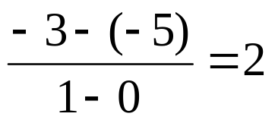
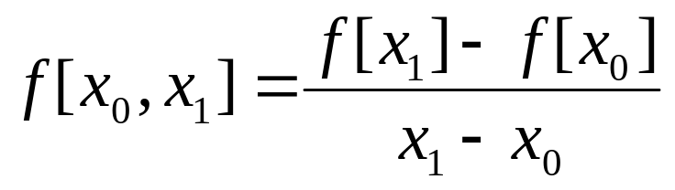
Divided Difference Table
0 | -5
1 | -3
-1 | -15
x | F[ ] | F[ , ] | F[ , , ]
0 | -5 | 2 | -4
1 | -3 | 6
-1 | -15
CISE301_Topic5

Slide 17
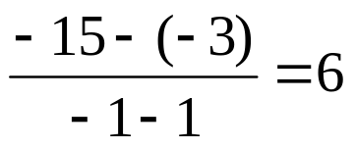
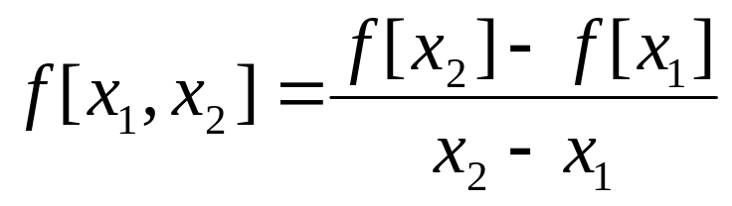
Divided Difference Table
0 | -5
1 | -3
-1 | -15
x | F[ ] | F[ , ] | F[ , , ]
0 | -5 | 2 | -4
1 | -3 | 6
-1 | -15
CISE301_Topic5

Slide 18
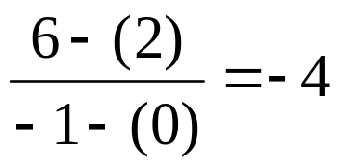
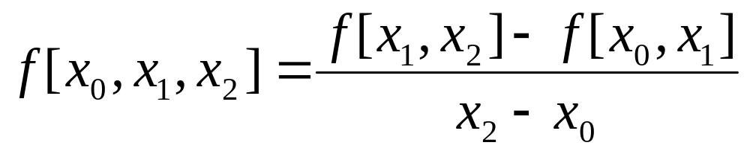
Divided Difference Table
0 | -5
1 | -3
-1 | -15
x | F[ ] | F[ , ] | F[ , , ]
0 | -5 | 2 | -4
1 | -3 | 6
-1 | -15
CISE301_Topic5

Slide 19
Divided Difference Table
0 | -5
1 | -3
-1 | -15
x | F[ ] | F[ , ] | F[ , , ]
0 | -5 | 2 | -4
1 | -3 | 6
-1 | -15
f₂(x)= F[x₀]+F[x₀,x₁] (x-x₀)+F[x₀,x₁,x₂] (x-x₀)(x-x₁)
CISE301_Topic5

Slide 20
Two Examples
Obtain the interpolating polynomials for the two examples:
x | y
1 | 0
2 | 3
3 | 8
x | y
2 | 3
1 | 0
3 | 8
What do you observe?
CISE301_Topic5

Slide 21
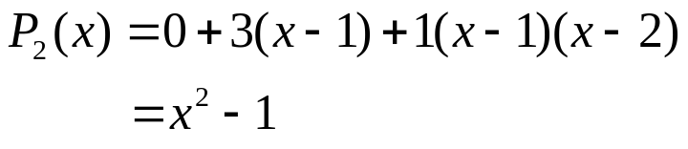

Two Examples
x | Y
1 | 0 | 3 | 1
2 | 3 | 5
3 | 8
x | Y
2 | 3 | 3 | 1
1 | 0 | 4
3 | 8
Ordering the points should not affect the interpolating polynomial.
CISE301_Topic5

Slide 22
Properties of Divided Difference
Ordering the points should not affect the divided difference:
CISE301_Topic5

Slide 23
Example
Find a polynomial to interpolate the data.
x | f(x)
2 | 3
4 | 5
5 | 1
6 | 6
7 | 9
CISE301_Topic5

Slide 24
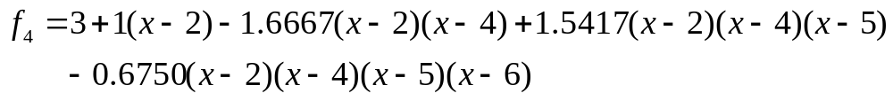
Example
x | f(x) | f[ , ] | f[ , , ] | f[ , , , ] | f[ , , , , ]
2 | 3 | 1 | -1.6667 | 1.5417 | -0.6750
4 | 5 | -4 | 4.5 | -1.8333
5 | 1 | 5 | -1
6 | 6 | 3
7 | 9
CISE301_Topic5

Slide 25
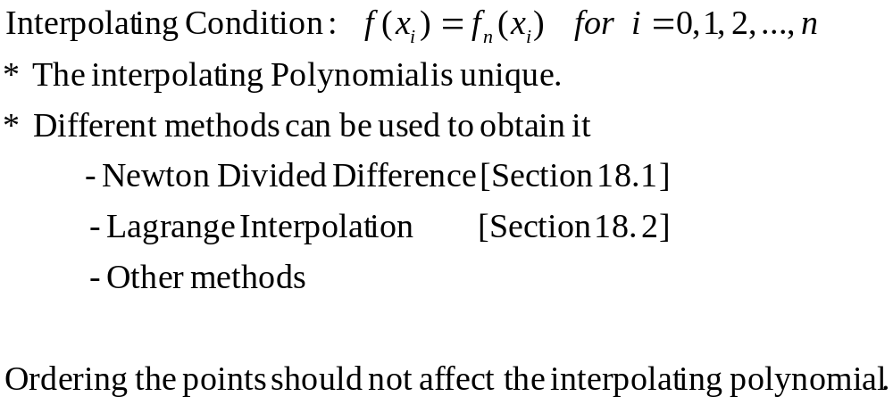
Summary
CISE301_Topic5

Slide 26
Lecture 21
Lagrange Interpolation
CISE301_Topic5

Slide 27
The Interpolation Problem
Given a set of n+1 points:
Find an n^{th} order polynomial:
that passes through all points, such that:
CISE301_Topic5

Slide 28








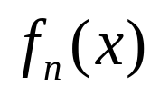

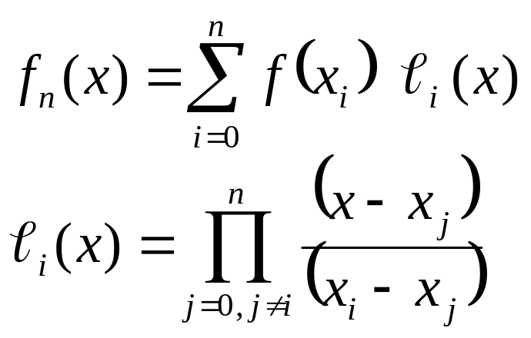
Lagrange Interpolation
Problem:
Given
Find the polynomial of least order such that:
Lagrange Interpolation Formula:
 |  |  | ….
 |  |  | ….
CISE301_Topic5

Slide 29
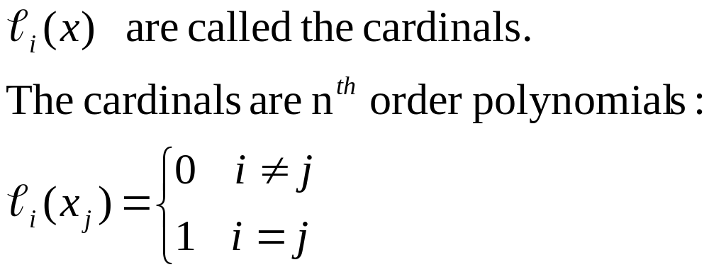
Lagrange Interpolation
CISE301_Topic5

Slide 30
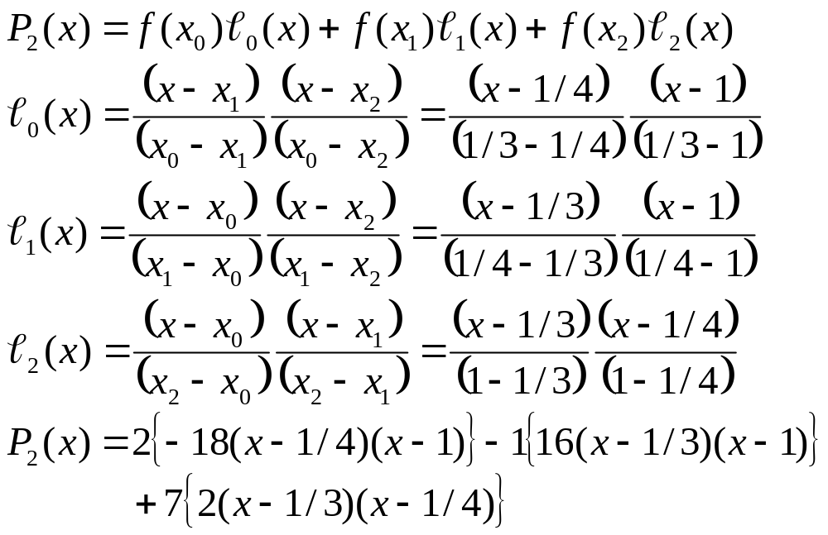
Lagrange Interpolation Example
x | 1/3 | 1/4 | 1
y | 2 | -1 | 7
CISE301_Topic5

Slide 31
Example
Find a polynomial to interpolate:
Both Newton’s interpolation method and Lagrange interpolation method must give the same answer.
x | y
0 | 1
1 | 3
2 | 2
3 | 5
4 | 4
CISE301_Topic5

Slide 32
Newton’s Interpolation Method
0 | 1 | 2 | -3/2 | 7/6 | -5/8
1 | 3 | -1 | 2 | -4/3
2 | 2 | 3 | -2
3 | 5 | -1
4 | 4
CISE301_Topic5

Slide 33
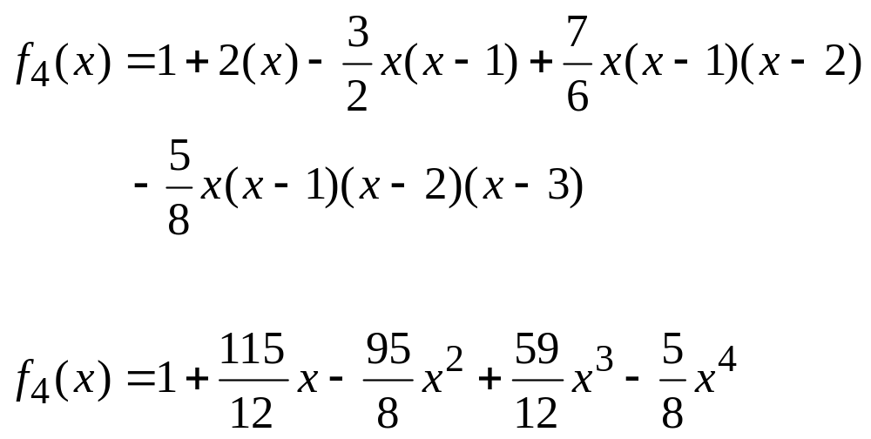
Interpolating Polynomial
CISE301_Topic5

Slide 34
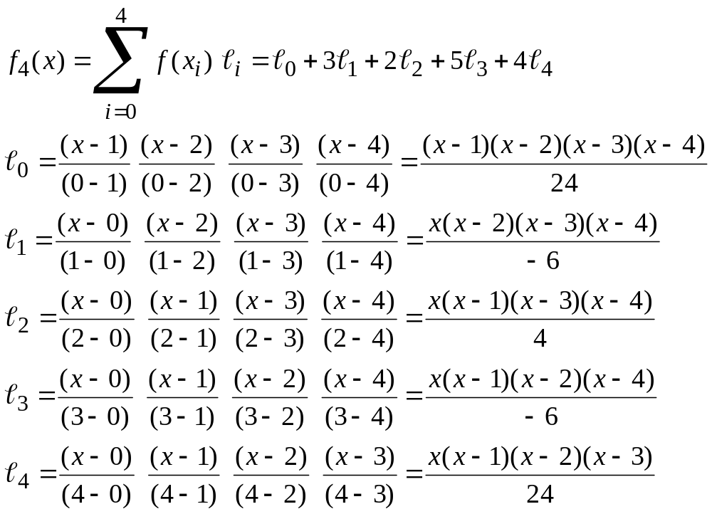
Interpolating Polynomial Using Lagrange Interpolation Method
CISE301_Topic5

Slide 35
Lecture 22
Inverse Interpolation
Error in Polynomial Interpolation
CISE301_Topic5

Slide 36
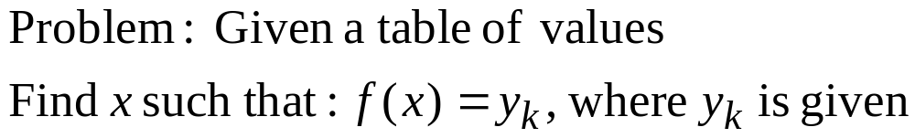
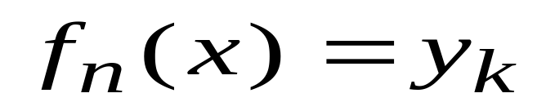
Inverse Interpolation
 |  |  | ….
 |  |  | ….
One approach:
Use polynomial interpolation to obtain f_{n}(x) to interpolate the data then use Newton’s method to find a solution to x
CISE301_Topic5

Slide 37
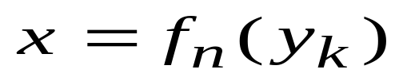
Inverse Interpolation
Inverse interpolation:
1. Exchange the roles
of x and y.
2. Perform polynomial
Interpolation on the
new table.
3. Evaluate
 |  |  | ….
 |  |  | ….
 |  |  | ….
 |  |  | ….
CISE301_Topic5

Slide 38
Inverse Interpolation
x
y
x
y
CISE301_Topic5

Slide 39
Inverse Interpolation
Question:
What is the limitation of inverse interpolation?
The original function has an inverse.
y₁, y₂, …, y_{n} must be distinct.
CISE301_Topic5

Slide 40
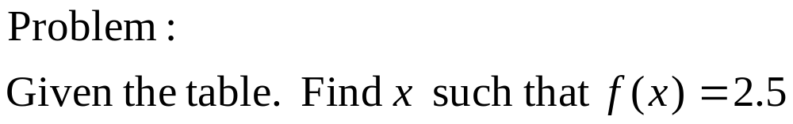
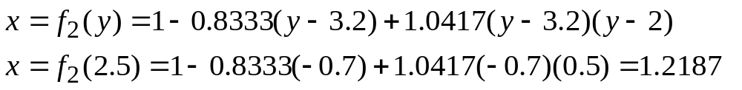
Inverse Interpolation
Example
x | 1 | 2 | 3
y | 3.2 | 2.0 | 1.6
3.2 | 1 | -.8333 | 1.0417
2.0 | 2 | -2.5
1.6 | 3
CISE301_Topic5

Slide 41
Errors in polynomial Interpolation
Polynomial interpolation may lead to large errors (especially for high order polynomials).
BE CAREFUL
When an n^{th} order interpolating polynomial is used, the error is related to the (n+1)^{th} order derivative.
CISE301_Topic5

Slide 42
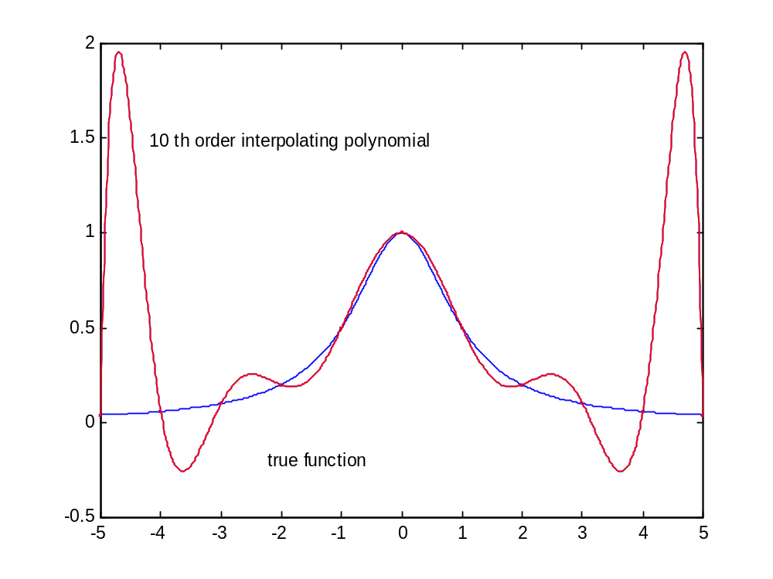
10th Order Polynomial Interpolation
CISE301_Topic5

Slide 43
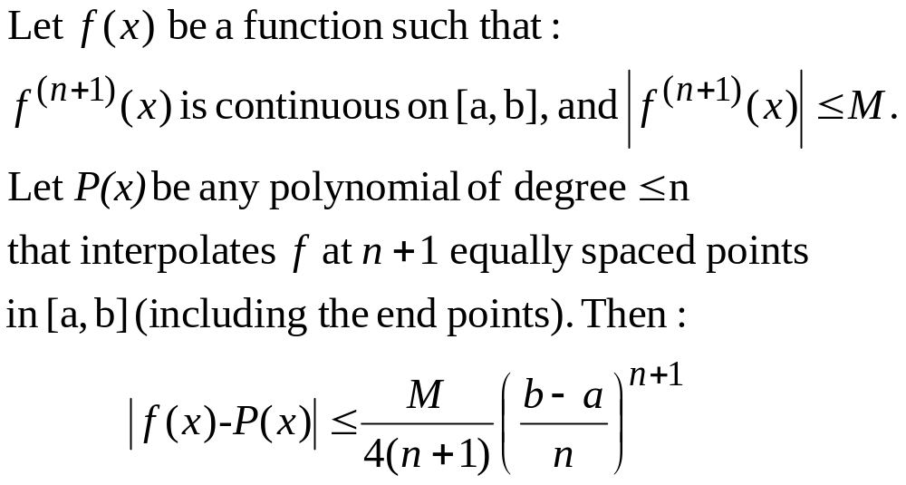
Errors in polynomial Interpolation
Theorem
CISE301_Topic5

Slide 44
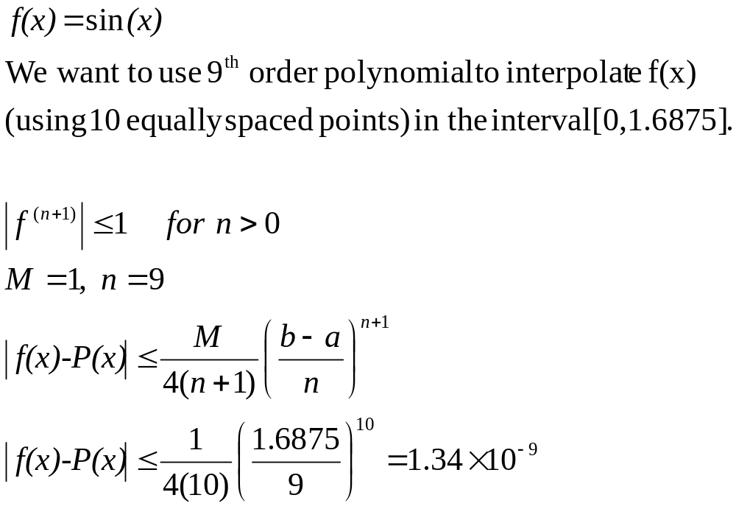
Example
CISE301_Topic5

Slide 45
Summary
The interpolating polynomial is unique.
Different methods can be used to obtain it.
  Newton’s divided difference
  Lagrange interpolation
  Others
Polynomial interpolation can be sensitive to data.
BE CAREFUL when high order polynomials are used.
CISE301_Topic5

